Slide 1

Off-policy Learning For Prediction
Notes:
1

Slide 2
Objectives
Understand how off-policy learning can help deal with the exploration problem
Understand importance sampling
Use importance sampling to estimate the expected value of a target distribution using samples from a different distribution.
Off-Policy Learning
2
Notes:
2

Slide 3
Off-Policy Learning
What is it ?
Off-policy learning is a reinforcement learning technique where the agent learns to estimate value functions, state-value function V(s) or action-value function Q(s,a)) from data generated by following a different behavior policy than the one being evaluated.
In off-policy learning, the behavior policy determines the agent's actions, while the target policy is the one whose value function the agent aims to estimate.
Off-Policy Learning
3
Notes:
3

Slide 4
Off-Policy Learning
On-Policy: improve and valuate the policy being used to select actions
Off-policy: improve and evaluate a different policy from the one used to select actions
Example:
Learning the optimal policy involves following a completely random policy, termed the target policy, as it serves as the objective for the agent's learning process
Off-Policy Learning
4
Notes:
4

Slide 5
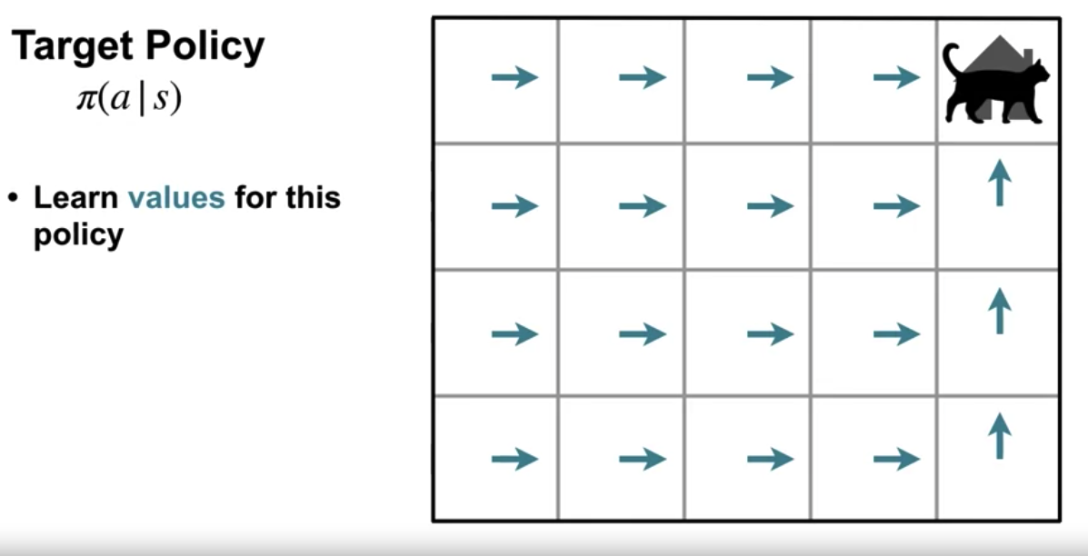
Off-Policy Learning
The value function that the agent is learning is based on the target policy. One example of a Target policy is the optimal policy we call the policy that the agent is using to select actions the behavior policy because it defines our agents Behavior.
Off-Policy Learning
5
Notes:
5

Slide 6
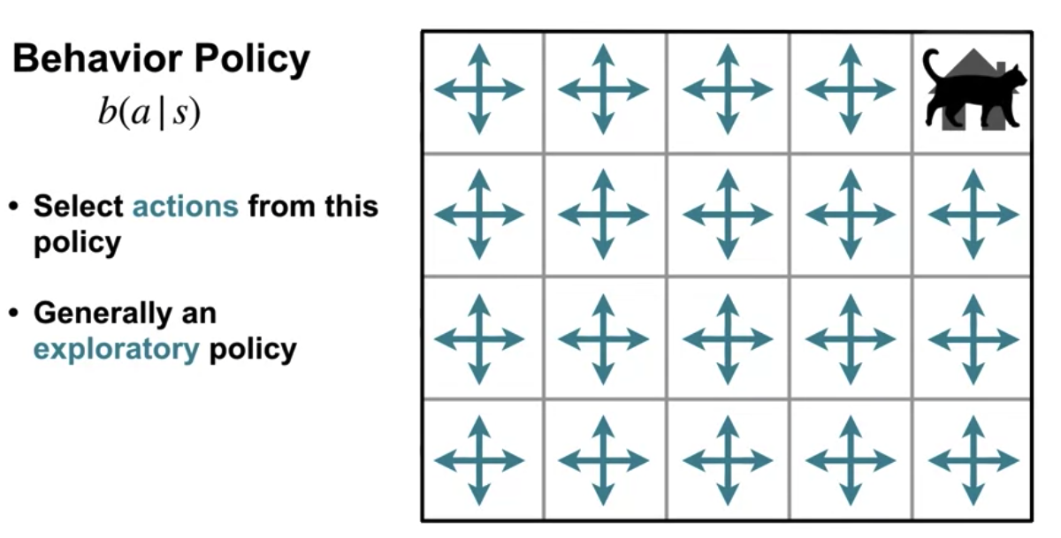
Off-Policy Learning
The behavior policy is usually denoted by B.
The behavior policy is in charge of selecting actions for the agent.
The behavior policies shown here is the uniform random policy.
Off-Policy Learning
6
Notes:
6

Slide 7
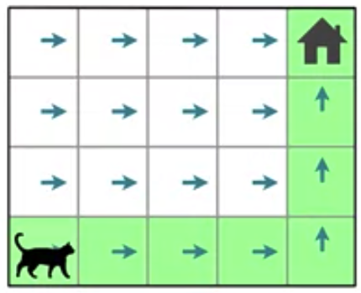
Off-Policy Learning
If our agent behaves according to the Target policy it might only experience a small number of states.
Off-Policy Learning
7
Notes:
7

Slide 8
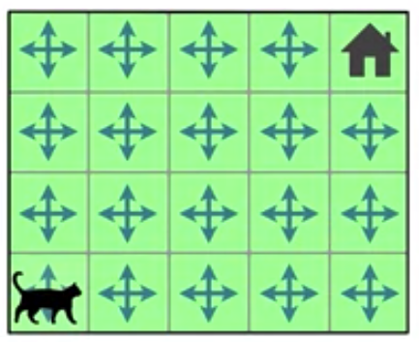
Off-Policy Learning
If our aging can behave according to a policy that favors exploration.
It can experience a much larger number of states.
Off-Policy Learning
8
Notes:
8

Slide 9
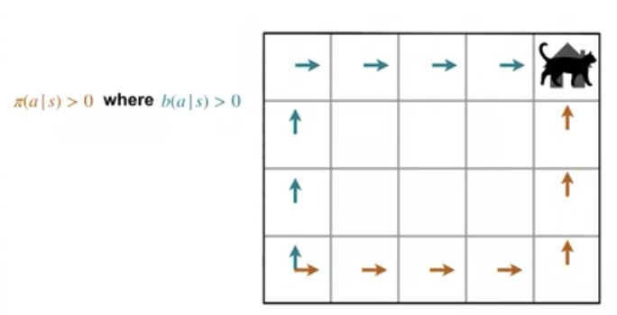
Off-Policy Learning
One key rule of off policy learning is that the behavior policy must cover the target policy.
If the target policy says the probability of selecting an action a given State s is greater than zero then the behavior policy must say the probability of selecting that action in that state is greater than 0
Off-Policy Learning
9
Notes:
9

Slide 10
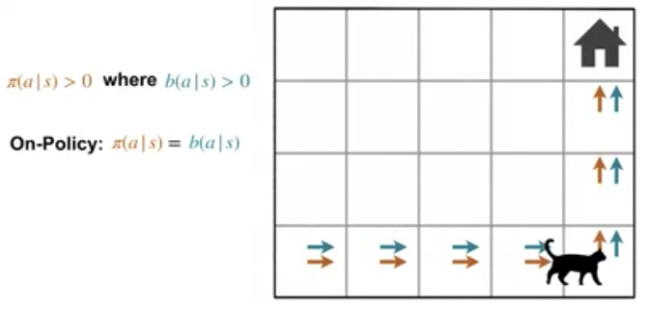
Off-Policy Learning
It's worth noting that off policy learning is a strict generalization of on policy learning on policies the specific case where the target policy is equal to the behavior policy.
Off-Policy Learning
10
Notes:
10

Slide 11
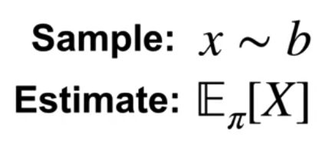
Importance Sampling
We have some random variable x that's being sampled from a probability distribution b.
We want to estimate the expected value of x but with respect to the target distribution Pi.
Because x is drawn from b, we cannot simply use the sample average to compute the expectation under Pi.
This sample average will give us the expected value under b instead.
Off-Policy Learning
11
Notes:
11

Slide 12
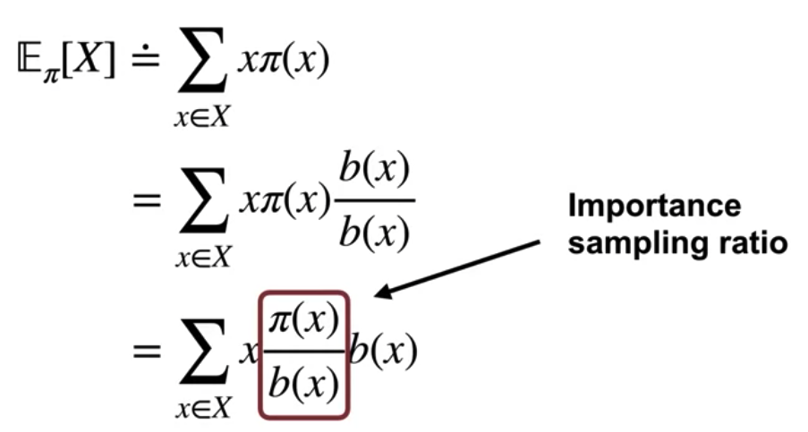
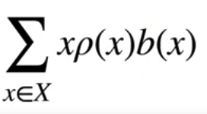
Importance Sampling
Importance sampling ratio
We can write the importance sampling ratio as Rho of x.
Off-Policy Learning
12
Notes:
12

Slide 13
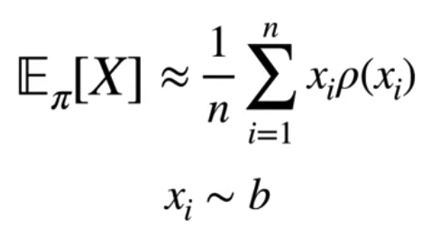
Importance Sampling
How do we use it to estimate the expectation from data?
We just need to compute a weighted sample average with the importance sampling ratio as the weightings
We can now estimate the expected value of x under distribution Pi by using the sample average, the samples drawn from distribution b.
Off-Policy Learning
13
Notes:
13

Slide 14
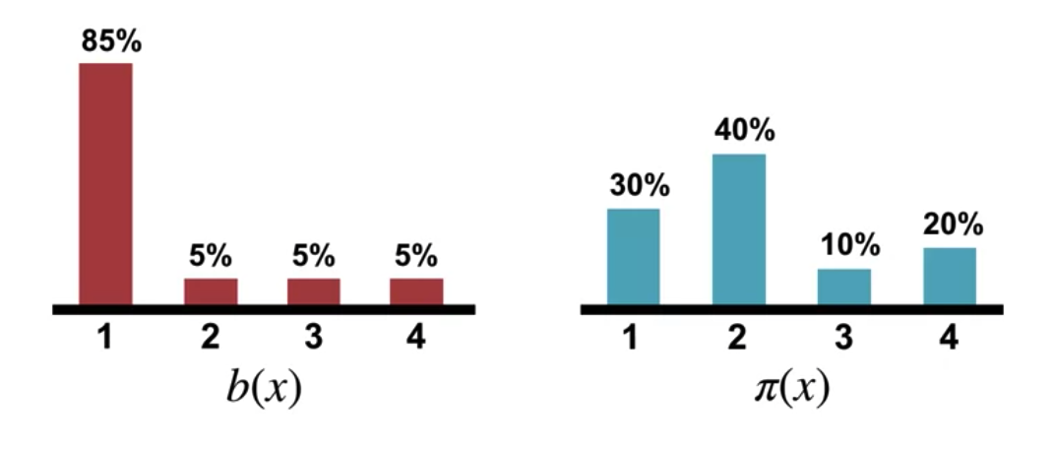
Importance Sampling
We have two rather different distributions: b and Pi. We'll draw samples according to b and try to estimate the expected value under Pi.
Off-Policy Learning
14
Notes:
14

Slide 15
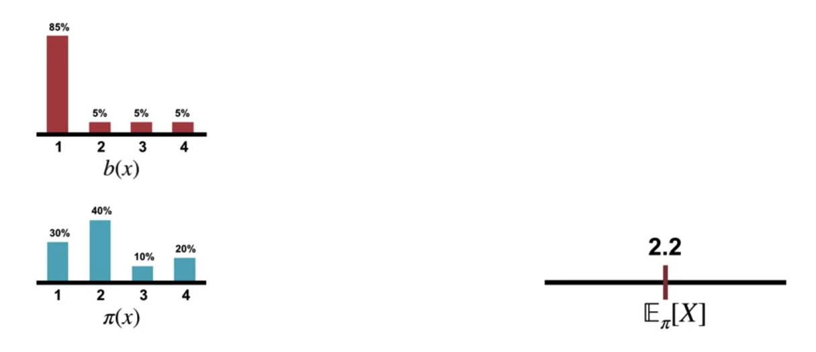
Importance Sampling
Draw samples according to b and try to estimate the expected value under Pi.
On the right: track of our current estimate for the expected value under Pi.
For reference, The true expected value is in the middle of the line.
Off-Policy Learning
15
Notes:
15

Slide 16
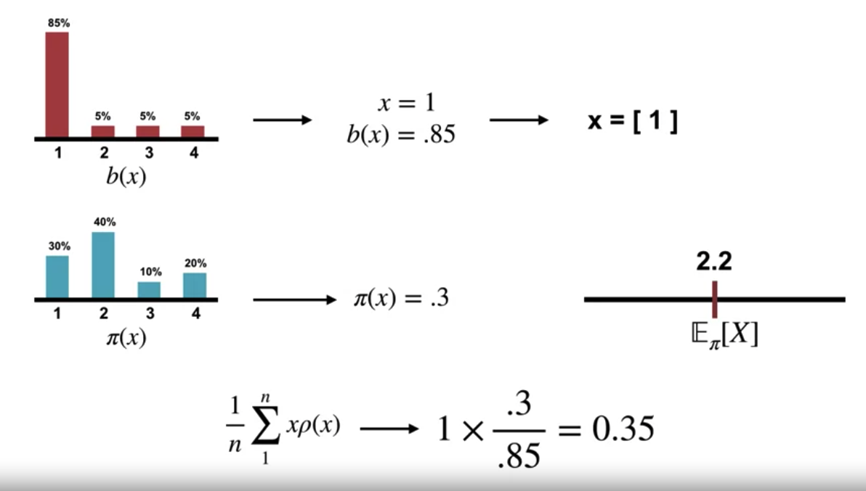
Importance Sampling
Sample from b( x=1), we get estimate of 0.35
Off-Policy Learning
16
Notes:
16

Slide 17
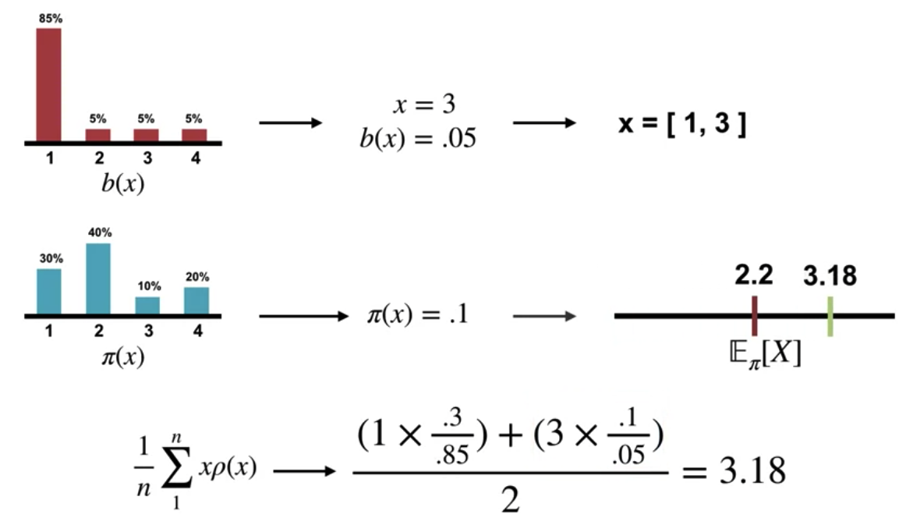
Importance Sampling
Sample from b( x=3), we get estimate of 3.18
Off-Policy Learning
17
Notes:
17

Slide 18
Summary
Understand how off-policy learning can help deal with the exploration problem
Understand importance sampling
Use importance sampling to estimate the expected value of a target distribution using samples from a different distribution.
Off-Policy Learning
18

Slide 19
Q & A
Off-Policy Learning
19

